Slide 1

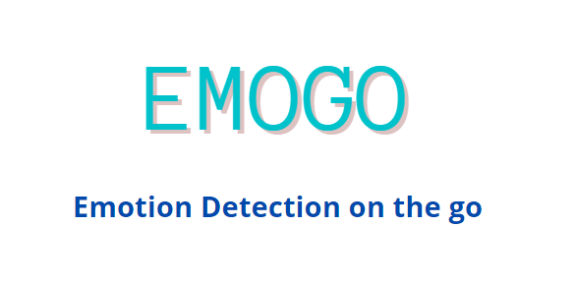


Presented By:
Alia AlHammadi
Ahmed Kazim
Ali Mohamed

Slide 2
ABSTRACT
Emotional Awareness
BPM & Temperature
Wearable Portable
Device
Machine Learning Algorithm
Monitoring patients emotion
Website

Slide 3

What is Emogo ?
It’s a platform that targets all users who seek to better their well-being
Reducing the stigma surrounding mental health
Detects 5 Emotion States

Slide 4

Emotional Awareness
Mental Health
New Field
Removing Barrier
Prevent Mental Health Struggles
Notes:
Optimum solutions

Slide 5
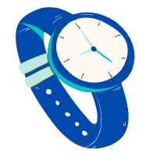


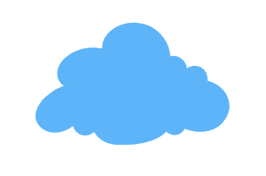
OUR SOLUTION
Portable Wearable Device
Train Data Set using Machine Learning Algorithms
Process Heart Rate Data
Develop Web Application
Notes:
Optimum solutions

Slide 6
How Emogo Started
Research about emotion detection
Select the best method
Implementation
Research different methods
Choosing BPM and Temp using KNN
Creating a website
Collect information on ML algorithms
Training Emotional states using KNN

Slide 7
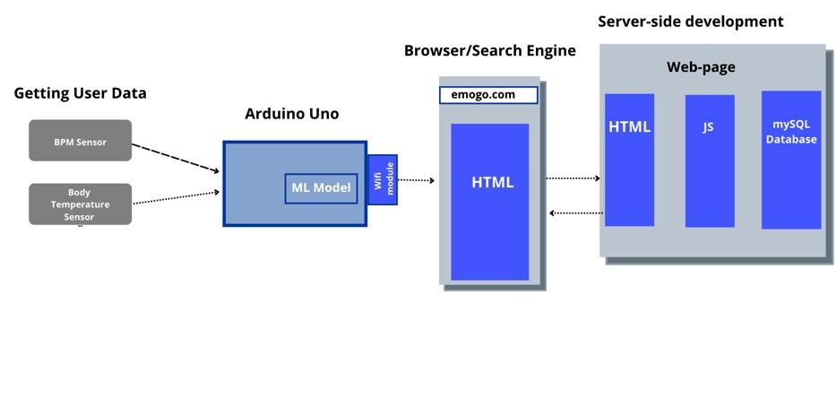
Block Diagram of Emogo System
Notes:
The html one
Upon request it comes from the server side

Slide 8

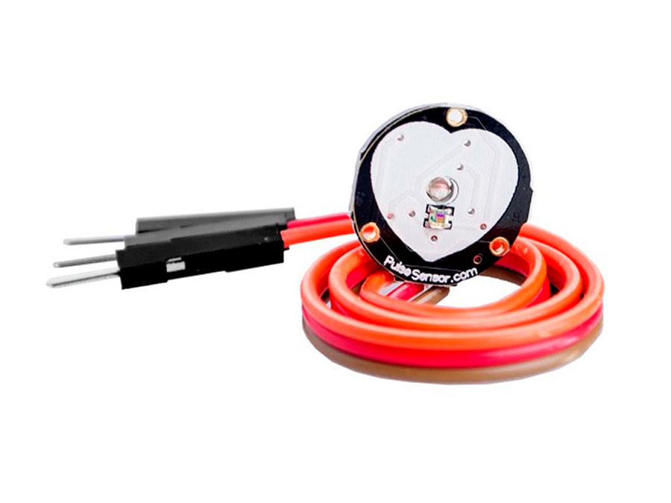

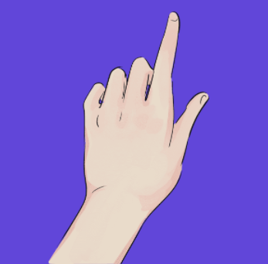
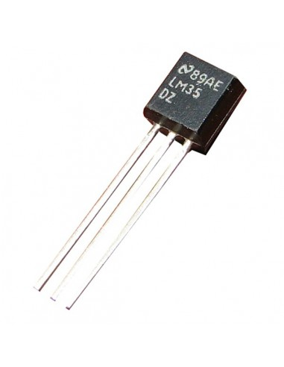
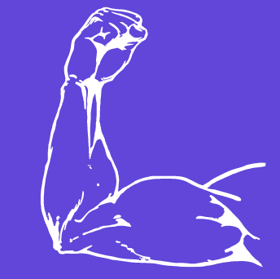
BPM & Temperature
Measure electrical conductance
BPM sensor
Skin contact
Strong emotion detection
Compatible
Temp Sensor
Notes:
XD-58C pulse sensor module is used to measure heart rates. It’s widely applied for students, artists, athletes, inventors, games, or mobile terminal developers to develop heart rate-related interactive works. You can wear the sensor on your finger or earlobe and connect it to Arduino. It also has an open-source APP program that can display your heart rate in real-time in graphs. It’s in short, a heart rate sensor integrated with an optical amplifier and noise elimination circuit.
–
The digital temperature sensor like DS18B20 follows single wire protocol and it can be used to measure temperature
The DS18B20 has an accuracy of ±0.5°C Accuracy

Slide 9
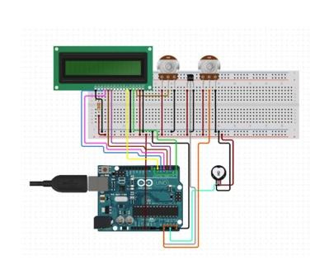
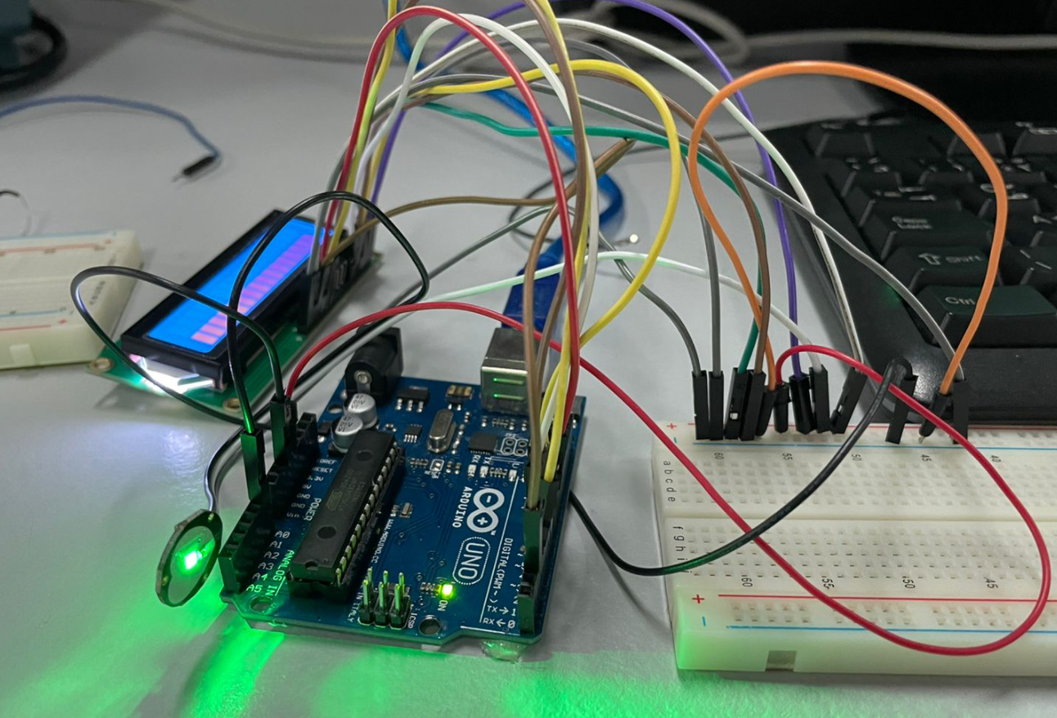
Hardware Setup
(XD-58C) Pulse Sensor & lm35 Temperature

Slide 10
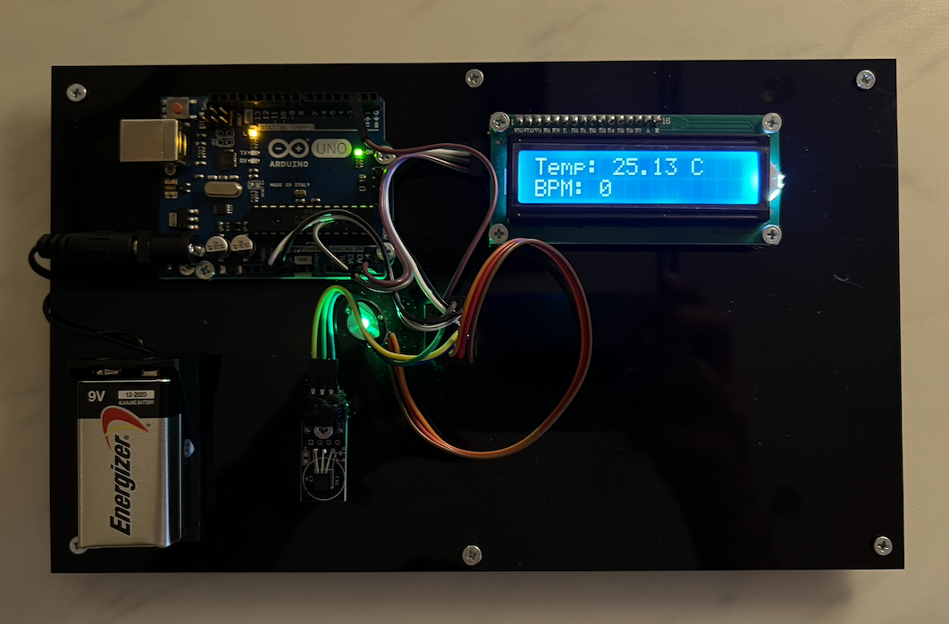
Experimental Prototype - MVP

Slide 11
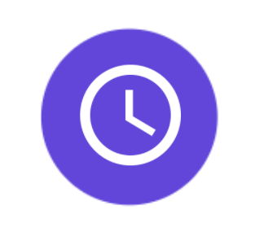

KNN - Machine Learning
Focus
Distance
Classification and Regression
Underfitting & Overfitting
K-Nearest Neighbor
Euclidean Distance
Notes:
The abbreviation KNN stands for “K-Nearest Neighbour”. It is a supervised machine learning algorithm. The algorithm can be used to solve both classification and regression problem statements.
–
The KNN algorithm employs the same principle. Its aim is to locate all of the closest neighbours around a new unknown data point in order to figure out what class it belongs to. It’s a distance-based approach.
—---
KNN calculates the distance from all points in the proximity of the unknown data and filters out the ones with the shortest distances to it. As a result, it’s often referred to as a distance-based algorithm.
In order to correctly classify the results, we must first determine the value of K (Number of Nearest Neighbours).
—-
Larger K value: The case of underfitting occurs when the value of k is increased. In this case, the model would be unable to correctly learn on the training data.
Smaller k value: The condition of overfitting occurs when the value of k is smaller. The model will capture all of the training data, including noise. The model will perform poorly for the test data in this scenario.

Slide 12
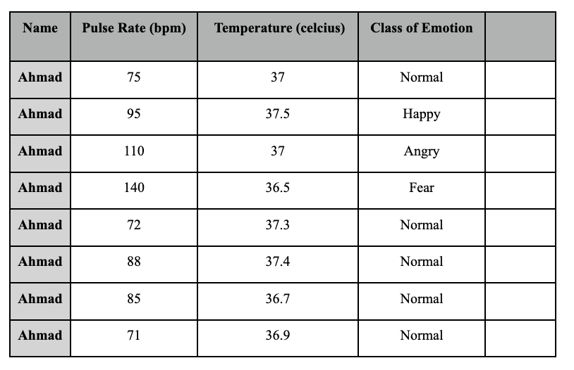
Feeding Dataset
Notes:
Try to inclue sadness
And ali and I should coordinate too ?

Slide 13
BPM & TEMPERATURE - ML Algorithm
Load the data
Initialize K
Calculate distance between query and current
Add the distance and index to an ordered collection
Sort from smallest to largest
Pick the first K entries from the sorted collection
Get the labels of the selected K entries
For classification return the mode of the K labels

Slide 14
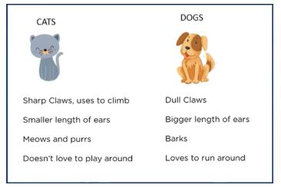
Measured Features

Slide 15
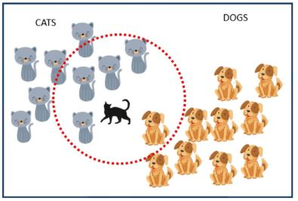
Classification

Slide 16
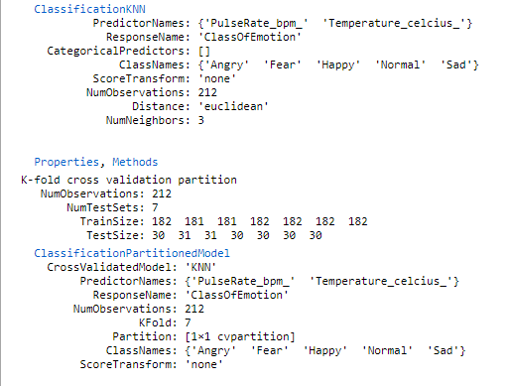
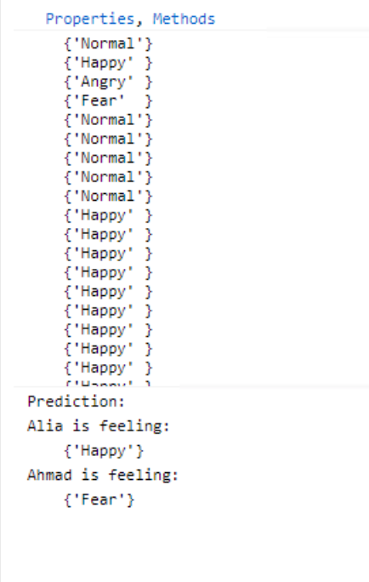
BPM & Temperature ML Result

Slide 17
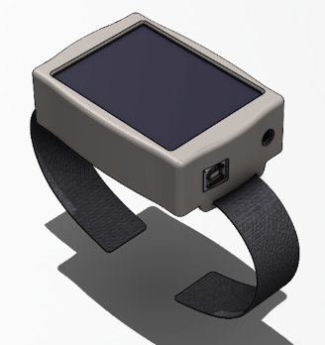
Prototype Design
Features of Wearable Device:
LCD screen
BPM Monitoring
Temperature Monitoring
Bluetooth
Emotional State

Slide 18
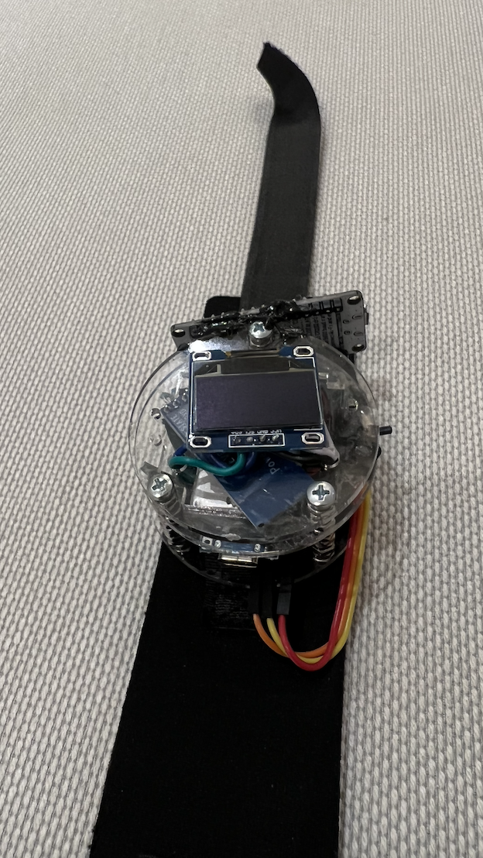
Final Portable Prototype
Components of Portable Prototype
Arduino pro mini
Oled Display Screen
Lipo Battery
Max30102 Heart Rate Sensor
Bluetooth Sensor
Microslide Switch

Slide 19
Prototype Constraints
Final device constraints
Battery Lifespan
Maintenance

Slide 20
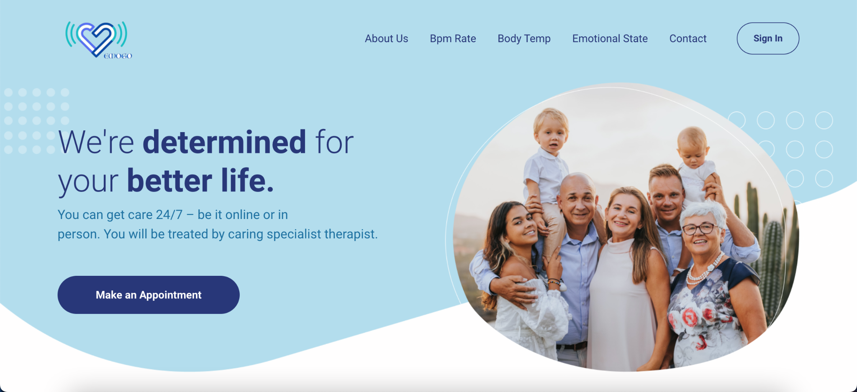
Website

Slide 21
Environmental, Economic, & Social Impact
BioDegradable
Carbon Footprint
We aim to have biodegradable straps
Reducing Carbon Footprint
Different Sensors
Saving Cost
We want to research more on different sensors which are more economic
There will be no need for manual checkups and appointment
Permission
Taboo
Asking users for permission of tracking data
Might be a cultural issue and taboo
Notes:
CARBON FOOTPRINT, since the therapists are online or can help you and track from a distance, you dont need to use transportations or waste energy
You are reducing your carbon footprint

Slide 22
Technical and Nontechnical Constraints
Advanced Technology
Knowledge
Budget
Sturdy technology to run the machine learning and coding software
Need knowledge on different softwares
The project might have a higher budget which many wont accept

Slide 23
Challenges and Risks
Cyber
Injury
Technology Errors
Data transmitted if not properly secured can be hacked
Malfunction can cause severe injuries
Companies can be held at an economic loss if the device is not functioning
Notes:
if data transmitted via wearables is not properly secured, companies can face class action lawsuits, costly fines and damage to their reputation
Malfunctioning devices can cause injuries, illnesses and even death of wearers or patients. Device manufacturers may face a product liability lawsuit
companies can be held liable for an economic loss from the failure of a device to work as intended.

Slide 24
Timeline
1
2
3
4
Initiating the project
Research
components
Researching and studying different ML algorithms
Testing the hardware
Integrating it with ML
Outputting the result on the Website
Initiating
ML research
ML - Hardware
Website

Slide 25
What's The Next Step For Emogo?
Components
Features
Applications
Investment
Research for components that are more lightweight
Add more features to the prototype and website
Based on psychiatrist Interview
With more time and financial support, we can install the emoji application on more platforms
With more time on our hands we are looking for investors to help further our device

Slide 26
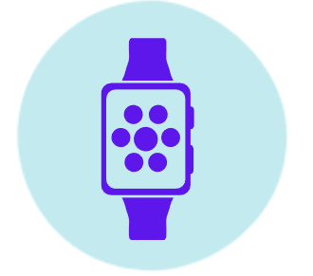
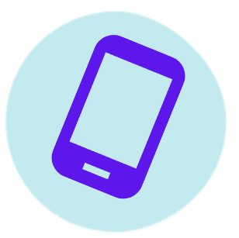
CONCLUSION
Our Goal
ML Model
Our goal is to spread awareness and help
interpreted through ML
Approach
Watch Band
How will it be achieved
Emotion detection smart watch
Sensors
Website
Mainly using two different sensors
Mood tracker

Slide 27
THE HEART NEVER LIES

